Slide 1

COMPUTER NETWORKS MODULE 3 PHYSICAL LAYER
By
Dr. Kanchan Shende

Slide 2
Module 3
The Physical Layer
Signals
Transmission Modes : Parallel Transmission, Serial Transmission
Digital data transmission : Line coding schemes
Analog data transmission : Types of digital-to-analog conversion, Types of analog-to-analog modulation
Physical Layer Devices : Repeaters, Hubs- active hub Passive hub
SOCS, MIT-WPU

Slide 3

Fundamental Principles of Physical Layer
SOCS, MIT-WPU

Slide 4
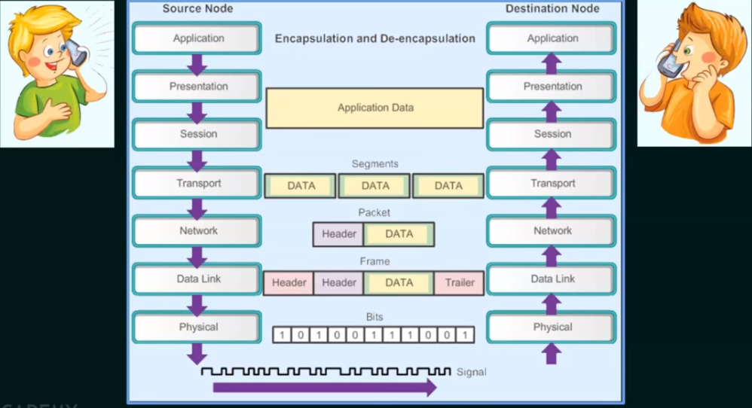
Conti…
SOCS, MIT-WPU

Slide 5
Physical Layer – Data and Signals
Data and Signals
Source / Destination
Data
Signals
SOCS, MIT-WPU

Slide 6
Conti…
Fundamental Principles of Physical Layer
One of the major functions of the physical layer is to move data in the form of electromagnetic signals across a transmission medium.
The data usable to a person or an application are not in a form that can be transmitted over a network.
For example, an image must first be changed to a form that transmission media can accept.
To be transmitted, data must be transformed to electromagnetic signals.
SOCS, MIT-WPU

Slide 7
Signals
It is a function that represents the variation of a physical quantity with respect to time.
Example : Variation in temperature of a city in one day i.e. 24 hours.
Two kinds of Signals
Analog Signal
Digital Signal
SOCS, MIT-WPU

Slide 8
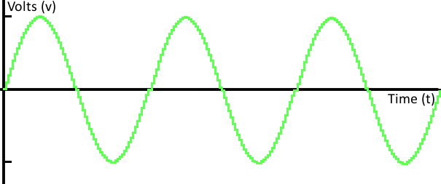
Conti…
Analog Signals
It is the signal that can be any value in the defined range
All real-life signals are analog in nature.
SOCS, MIT-WPU

Slide 9
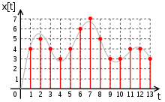
Conti…
2. Digital Signals
It is the signal that can take on of the finite values at any given time.
In case of digital signals, we discretize both time and magnitude.
SOCS, MIT-WPU

Slide 10
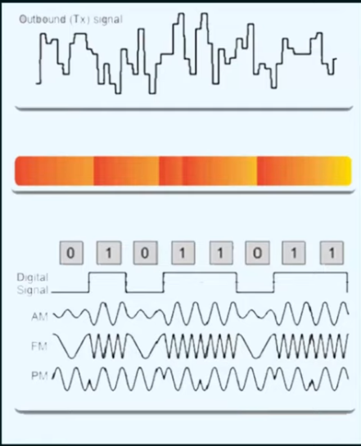
Physical Layer Media
Electrical Signals Copper cable
Light pulses Fiber Optic cable
Microwave signals Wireless
SOCS, MIT-WPU

